Slide 1
TIMSS 2023 DATA COLLECTION Verifier Training
OCTOber 2022

Slide 2
In this training…
1. Intro & Overview
2. Commenting
3. Questionnaires
4. Assessment Items

Slide 3
Full vs focused verification
Full verification
Comparison target vs source -> entire materials
Focused verification
For English target versions
Restricted to checking the national adaptations, source updates (if any) and potentially necessary adaptations

Slide 4
1. Intro & Overview

Slide 5
About IEA
IEA
Who is IEA:
Non-governmental research organization, founded in 1958 at the UNESCO Institute for Education in Hamburg, Germany.
Independent, cooperative of international national research institutions and governmental research agencies.
Conducts large-scale, comparative studies of educational achievement and other aspects of education.
More than 60 member institutions; nearly 100 education systems participate in IEA studies.
Major Studies of IEA:

Slide 6
About TIMSS
IEA
Who is the target?
Students enrolled in the fourth and eighth grade, provided that the average age of students is at least 9.5 years and 13.5 years respectively.
How often?
The study has been conducted every four years since 1995 (8th cycle)
What does the assessment evaluate?
TIMSS focuses on effectively measuring student achievement in mathematics and science across about 60 education systems
What other information is collected?
Contextual data from students, teachers, home, and schools.

Slide 7
About TIMSS
Slide presented by IEA
IEA
The purpose of this study is to effectively measure the educational achievement in mathematics and science at the fourth and eighth grades, and sometimes the final year of secondary school.
The study is designed to capture the breadth and richness of these subjects as they are taught in the participating countries. The study collects detailed information about curriculum and curriculum implementation, together with empirical information about the contexts for schooling.

Slide 8
Process
Translation
by Country
Verification
by YOU
Review
by IEA
Review
by cApStAn
Stay tuned for a week after your delivery so as to react promptly to possible queries

Slide 9
What is verification?
Translation Review + Documentation
S
T

Slide 10
What is verification?
Validation
Translation Adaptation Guidelines
Style guide
Adaptations, country comments
Correction
Equivalent to source
Linguistically correct
Edit the target
Documentation
Codes + comments
In ENGLISH

Slide 11
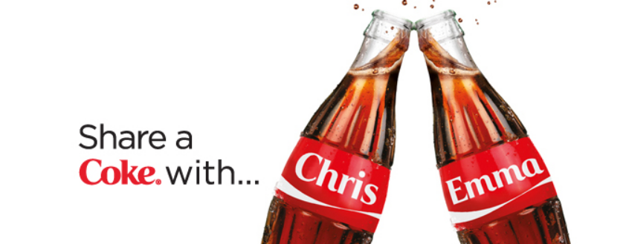
What is Adaptation?
“an intentional deviation from the source version made for cultural reasons or to conform to local usage”

Slide 12
Platforms
Assessment Master (AM)
Source QQ & reference files
Target QQ
Errata file
TIMSS 23 FT Verified Version
Verification guide
Video tutorials
Assessment items (CBA)
Source, target, comments

Slide 13
2. Commenting

Slide 14
Severity codes
Codes | Explanation
Code 1 | The translation contains a severe error that affected the meaning or difficulty of the item
Code 1? | Used whenever in doubt about the severity of an issue or unsure of how to correct a possible error
Code 2 | Indicates a minor change or error that did not affect the comprehension
Code 3 | Used to suggest an alternative wording for an otherwise appropriate translation
Major
Translation issues
Confirmation
 | If a national adaptation is implemented as documented -> enter “Adaptation implemented as documented. Requires ISC approval.”
No code

Slide 15
Standardised comments
List of standardised comments
Automatically generated
List also available in verification instructions page
Example: Text not bolded / italicized / underlined / capitalized as in source. Changed by VER.

Slide 16
Documenting
IEA
COG
QQ
Report all issues
Code 1
Code 1?
Code 2
Code 3
If the national adaptation was implemented as documented enter “Adaptation implemented as documented. Requires ISC approval.”
Report all issues
Code 1
Code 1?
Code 2
Code 3
Code 1
Code 1?
Code 2 only if the national adaptation listed by the country had an error in target
Code 3
If the national adaptation was implemented as documented enter “Adaptation implemented as documented. Requires ISC approval.”

Slide 17
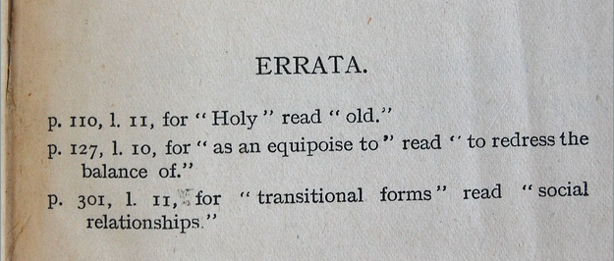
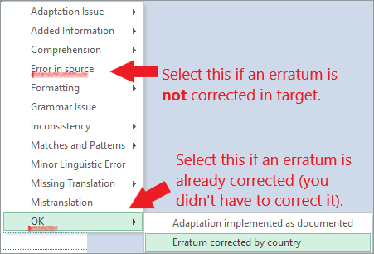
Errata
In books: a correction of a published text
In survey ver. projects: corrections/updates/error notifications found AFTER the release to translators

Slide 18
3. Questionnaires (QQ)

Slide 19
You will receive…
Source files
Target files
NAF
(National Adaptation Form)

Slide 20
You will deliver…
Target files - verified
NAF - commented

Slide 21
Questionnaires – Clarity!
Purpose:
Collecting background (contextual) information
When were you born?
Does your school have a school library?
Has your child attended extra lessons or tutoring?
How long have you been teaching?

Slide 22
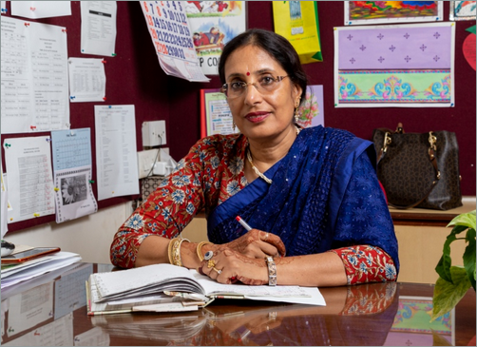
Target audience
Tc
H
St G4
Adults
Consider age, ethnic, social, educational background
Form of address (formal vs informal “you”), gender -> refer to the Style Guide.
St G8
Sc
School-going children
Educated adults

Slide 23
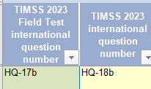
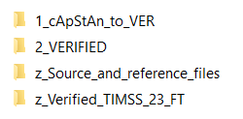
You can consult TIMSS 23 FT QQ
Many countries took TIMSS FT 2023 questionnaires
TIMSS 2023 FT - TIMSS 2023 DC mapping in NAF
TIMSS FT 2023 target questionnaires available on NextCloud
Do NOT verify 2023 FT QQ!
Do NOT check for identicalness (= do not report differences between 2019 and 2023).

Slide 24
COUNTRY Specific Adaptation

Slide 25
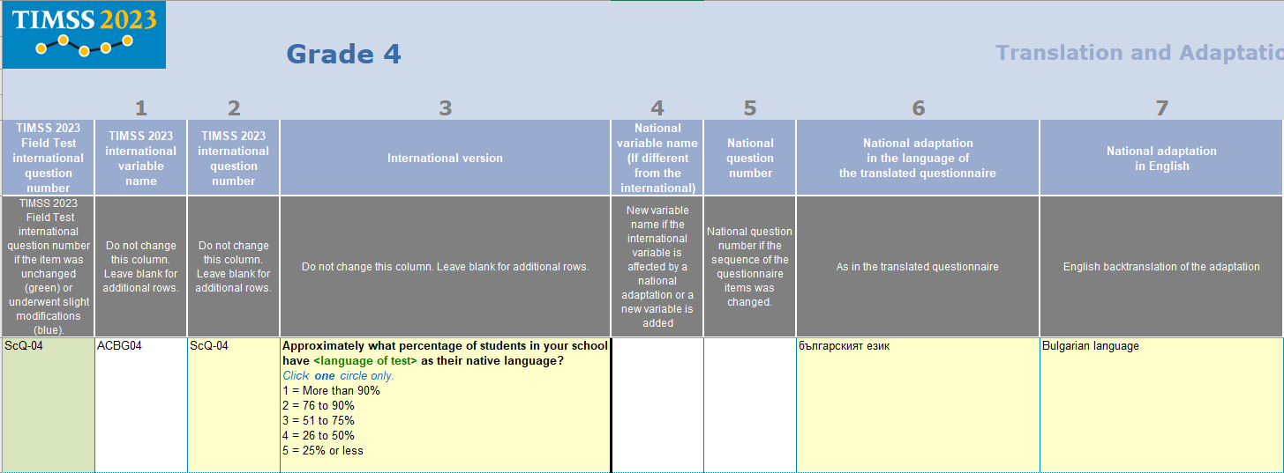
Forced Adaptation

Slide 26
ForCED AdapTation

Slide 27
NAF
Light blue
Dark blue
Reminder: VER not required to judge the appropriateness of the required adaptation. Do not “approve” adaptations.
Ctrl +M

Slide 28
NAF EXamPLE

Slide 29
Questionnaire checklist
Consistency – within question, between questionnaire(s), scales
Same sequence as source – keep same order of elements
Clear and fluent – avoid ambiguity
Complete – temporal and spatial framework (“at home”, “most of the time”)
Formatting – underline, bold, italics
Adaptations – <required> and other country-specific adaptations

Slide 30
Example
Source: I feel appreciated as a teacher
Back-translation of target: I am grateful as a teacher

Slide 31
Example
Source: How many <eighth grade> students experience difficulties understanding spoken <language of test>?
Back-translation of target: How many eighth-grade students experience difficulties understanding French?

Slide 32
ExampLE
Source: Did your school provide these additional remote learning resources during the COVID-19 pandemic?
Back translation of the target: Did your school provide these additional learning resources during the COVID-19 pandemic?

Slide 33
Adaptation in Questionnaire
Required adaptations: marked with angle brackets, cells highlighted in NAF
Notes:
ISCED – International Standard Classification of Education

Slide 34
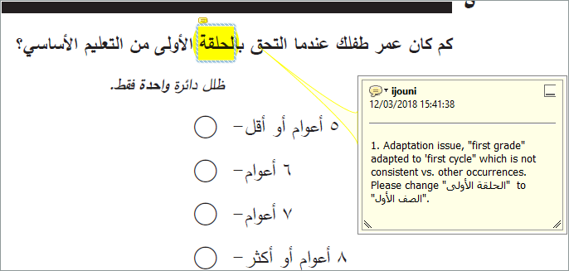
Sample verified QQ

Slide 35
Sample verified QQ

Slide 36
Question stem-response match

Slide 37
Questions?

Slide 38
Recurring issues
IEA
Recurring edits
Before applying massive changes for the recurring issues such as formal vs informal “you”, contact cApStAn PM
In COG: one general comment in each item
In QQ: one general comment throughout the QQs

Slide 39
4. Assessment Items (COG)
Notes:
COG = Cognitive items

Slide 40
You will receive…
Access to AM
AM contains Source, Target and Commenting functionality
Style guide
Contains country specific information on national conventions

Slide 41
You will deliver…
By notifying cApStAn PM that you completed verification on AM

Slide 42
Assessment items – difficulty level!
Purpose:
Measuring Student Achievement
1000 - 420?
Which picture is a human heart?
Which unit is the longest – cm, km, m, mm?

Slide 43
Adaptations in assessment items
People’s names: e.g. Peter > Pedro
Workweek as Monday through Friday
Seasons, places, animals, plants
Currency Zed not to be adapted
Real people’s name not to be adapted

Slide 44
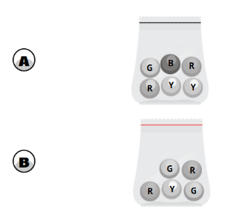
ExamPLE
Source: There are four bags with green (G), blue (B), yellow (Y), and red (R) balls.
Aryam picks one ball from each bag at random.
From which bag does she have the lowest probability of picking a red (R) ball?

Slide 45
IEA
Demo of AM

Slide 46
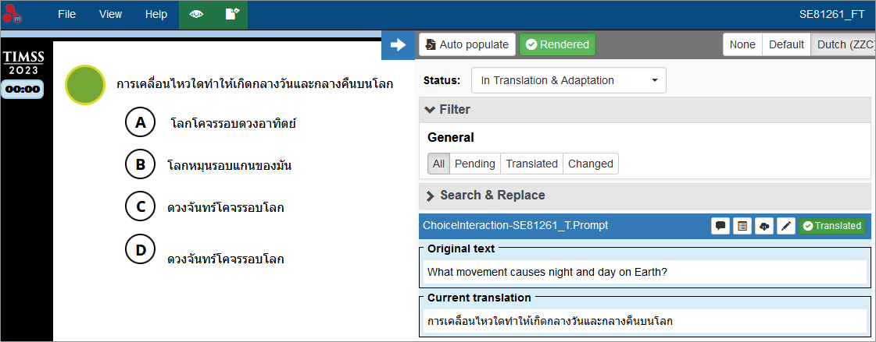
Items from FT
Review all elements and apply changes before Publishing

Slide 47
Remember to…
Publish!

Slide 48
Thank you!
cApStAn Project Managers
Emel
Shinoh
Tanya
IEA Project Managers
David
Jan-Philipp
Anna

